Slide 1
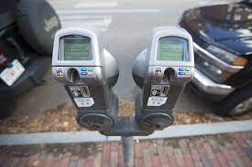
Are coins redundant?
By: Rayhan Aurelio CS777 Project

Slide 2
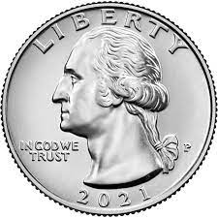
Background
Isn’t it annoying that every time we park our car and have some spare change, it only accepts quarters?
The goal of this project is to find out whether or not we should start phasing coins from parking meters and perhaps coins altogether.

Slide 3
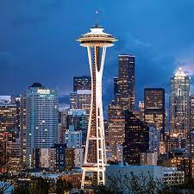
About the dataset
The dataset was obtained from the Seattle Open Data website, and comprises of 131187 transactions from parking meters in the city of Seattle in the month of August 2022.
It contains data such as type of payment used (phone, credit card, coins), the amount paid, the duration taken, and location.
https://data.seattle.gov/Transportation/Paid-Parking-Transaction-Data/gg89-k5p6

Slide 4

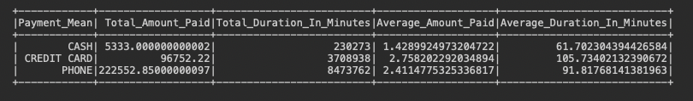
Exploration
As we can see, there are definitely more non cash payments than other means.
Also, it is worth noting that while the total amount paid and duration stayed is greater by phone payments. And also more phone payments, the average amount paid and average duration stayed is greater from credit cards.

Slide 5
Objective
To determine whether or not, the duration of stay and amount of payment will affect the type of payment used.

Slide 6
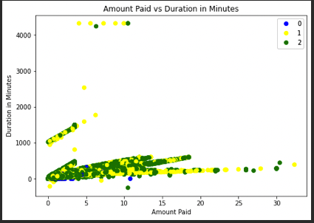
Clustering Results
0: Cash, 1: Credit Card, 2 : Phone
No Clusters, however notice that cash payments are only located on the bottom left.

Slide 7
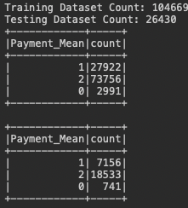
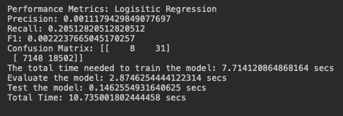
Logistic Regression
Poor logistic regression result, meaning that payment is truly random based off duration and amount paid.

Slide 8
Now let’s see what happens when we set it to cash and non cash

Slide 9
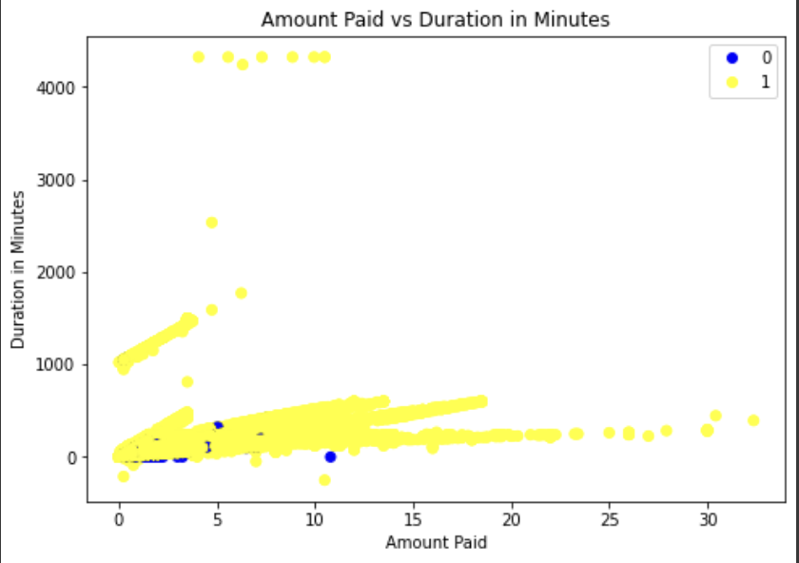
Clustering Results
It looks like people generally don’t pay with cash and even if they do, it is either a small amount or they are staying for a short duration.

Slide 10
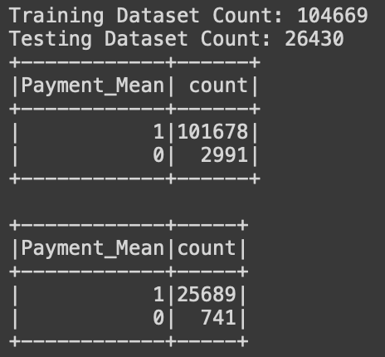
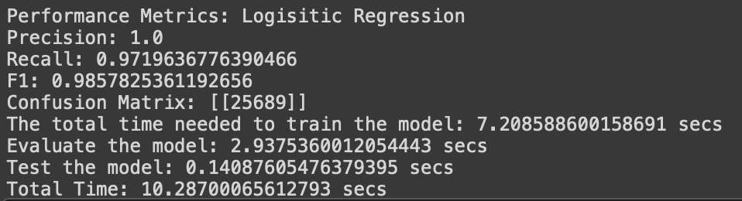
Logistic Regression
Good logistic results but only because most people pay by other means

Slide 11
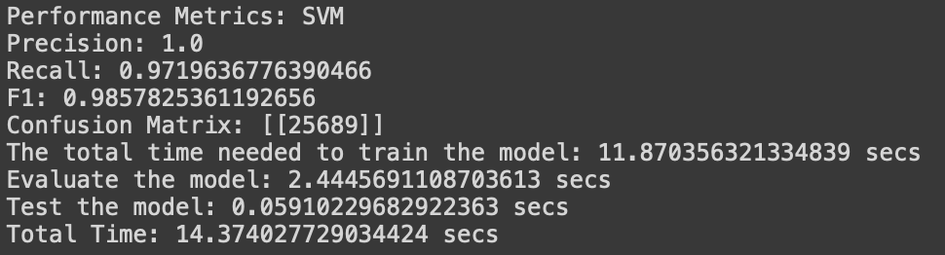
Linear SVC
Good SVM result.

Slide 12
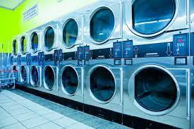
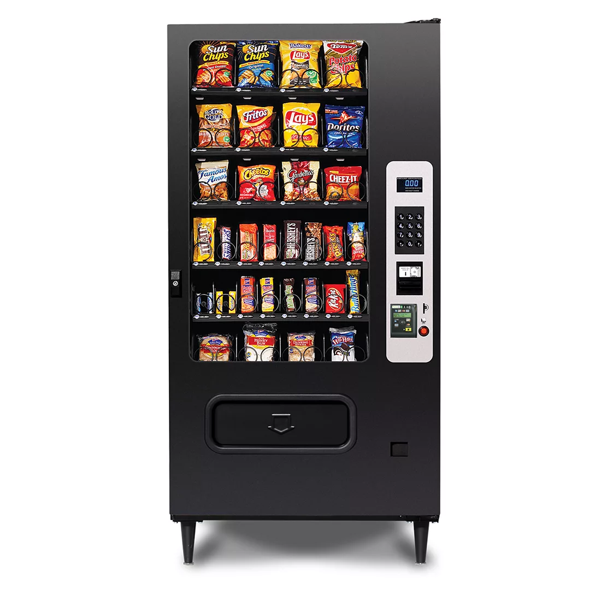
Conclusions
As we can see, citizens seem to be favoring non coin payments compared to coin payments.
This makes sense considering the fact that people can extend their parking without the need of walking back. And the convenience of cards.
However, parking meters are here to stay so long as coins are still around. Same logic applies to vending machines and laundromats.

Slide 13
Thank you for listening.

